Slide 1
Welcome!
2024 Troop Cookie Manager Training

Slide 2
Agenda
Program Overview
Engaging Troops, Families & Girls
Cookie Product Updates
Managing the Cookies
Managing the Cookie Finances
Smart Cookies
Digital Cookies
Q&A

Slide 4
NEW FOR 2024
New cookie mascot & theme
New cookie price & proceeds
All varieties are $6
Consumer price adjustment tip sheet
Nine varieties from ABC Bakers
New sales platform for Girl Scouts & Troops for online sales
Digital Cookie
Updated shipping promotion

Slide 5
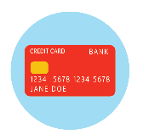
Popular features are back!
GSRV will cover 100% of the credit card transaction fees for troops that use Digital Cookie to take credit card payments on any device!
Updated shipping promotion!
$5 off shipping for 6+ package purchases starting February 8:
Minimum order of 4 packages
Limited time promotion!
Shipping rates on Cookie Central
Refreshed patch program opportunities

Slide 6
Your Girl Scout Cookie Favorites Are Back!
Nine cookie varieties
All varieties are $6 per package
View nutritional & allergen information on Cookie Central
Information also available on your order card

Slide 7
You’re Invited! Cookie Retail Open Houses
Come join in the fun! Shop for fun cookie items, enter the prize drawings, sample cookies, view the cookie rewards, test out Digital Cookie & meet the Product Program Team.
Brooklyn Center Retail Shop: Jan. 27, 9am – 1pm
Mankato Retail Shop: Jan. 27, 9am – 1pm
St. Paul Retail Shop: Feb. 3, 9am - 1pm
Rochester Retail Shop: Feb. 3, 9am - 1pm
We can't wait to see you!

Slide 8
Cookie Rallies
Service unit cookie rally on January 20th
Council-wide Virtual Cookie Rally on February 6
Details in The Cookie Press

Slide 9
Key Dates for 2024 Cookie Program
Cookie Booth Lottery opens | January 7
Cookie Booth Lottery selections awarded | January 14
Troop Initial Order Deadline | January 19
Service Unit Initial Order Deadline | January 20
Online Sales & Presales Begin | February 8
Cookie & Booth Go Day | February 16
Cookie Program Ends | March 24
Troop Reward Deadline | April 2
SU Reward Deadline | April 3
Girl Rewards ship to SUs | Week of May 27

Slide 10
Troop Cookie Manager Role Overview
Complete training
Read the Cookie Press emails EVERY WEEK
Distribute materials
Set goals
Host a Family Cookie Business Meeting
Manage cookie inventory
Manage Smart Cookies and Digital Cookie
Distribute rewards
Complete the online Troop Cookie Responsibility Form by Feb. 1

Slide 11
Cookie Policies
Find policies on Cookie Central
No changes from 2023
Cookie digital sales policies remain in place:
Not Allowed: Sales on Craigslist, eBay, Facebook Marketplace, or any Garage Sale Sites
Contact River Valleys if you have further questions

Slide 12
Responsibility Forms
Troop Cookie Manager Responsibility Forms:
https://form.jotform.com/203420671868155
Here’s my email address to add to the form: WayzataGirlScouts@gmail.com
Due February 1st
Family Responsibility Forms:
Troop Cookie Managers should:
Establish Family Return Date + add to Family Guide (recommended March 6 or earlier)
Provide families with your email address and troop number to enter
Confirm you have received forms from all participating families
Do not distribute or allocate cookies to girls they have not submitted form
https://form.jotform.com/203418711292148
You and the families will both receive a confirmation email
*Forms located on Cookie Central also

Slide 13
Cookie Resources:
Online:
Cookie Central (GirlScoutsRV.org)
The Cookie Press
Cookie Guidebooks for Troops
Smart Cookies Guides for Volunteers
Digital Cookie Guides for Families and Volunteers
Cookie Cupboard information
A mix of program essentials & fun
Cookie Swap
Facebook Group – Girl Scout River Valleys Troop Product Program Volunteers
Print:
Troop & Girl Scout materials
Troop Cookie Companion – troop cookie manager checklist!
Cookie Booth Packet
Cookie Lanyard

Slide 14
Cookie Business Meeting
Check out the online Family Cookie Business Meeting resources
Set a time/date and invite families (virtual or in-person)
Meeting topics:
Cookie sales options & resources
Family Cookie Responsibility Form
Setting Cookie Goals
Volunteer Opportunities – what do you need help with?
Cookie Return Date
Troop Cookie Calendar
Payment options
Cookie Materials

Slide 15
Setting Goals
Troop goals
Camp, travel, community service project
Individual Girl Scout goals
Rewards
Plans to achieve the goals
Inform parents/guardians
Report on the progress during the sale

Slide 16
Cookie Rewards
Plush, patches, & fun stuff oh my!
New & returning items
Cookie Credits & Camp Coupon
Troop PGA rewards
Full details on Cookie Central & in your cookie materials shipment

Slide 17
Ways to Sell
Online
Digital Cookies sales link and emails/social media
Phone or text
Call customers
Text an ask or Digital Cookies sales link
Cookie Booths
Virtual
In Person
Door-to-Door and Mobile Sales
Business Cards/Door Hangers
Bring Inventory or take orders
Workplace
Order card and hand written letter ask
Email Digital Cookies link
“Cube-to-Cube” sales
Business-to-Business
Make a pitch!

Slide 18
Cookie Program Participation Options
Three cookie participation options:

Slide 19
Pre-Sales & Online Sales
Pre-Sales & Online sales begin on February 8
Connect with cookie customers early
Record cookie orders on order card and/or share Digital Cookie site/emails
Deliver on Cookie Go Day

Slide 20
Cookie booths: 2023 Stats
Over 14,000 booth timeslots attended by Troops
Nearly 30% of cookie sales are through booths
Average sales per hour LY: 33
Booth hours by chain:
Troop-secured: 34%
Cub: 27%
Walmart: 14%

Slide 21
Cookie Booths: Council-secured Partners

Slide 22
Cookie Booth Sign-up Calendar:
Council-Secured Booths
Lottery Selections: January 7-14 at 11am
Lottery Runs: January 14 at 12:00pm
FCFS Dates: January 17, 18, 19, 20, 31

Slide 23
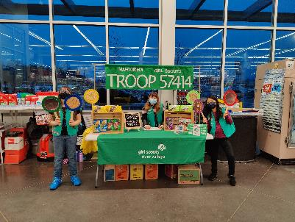
Cookie Booths: Troop-secured
Drive-thru booths
Family –friendly Craft breweries
Convenience stores
Car dealerships
Places of worship
VFW/American Legion
Virtual booth sales
Lemonade Stands
Check the Do Not Contact List First!

Slide 24
Troop-secured Cookie Booth Tips
Remind troops to submit requests as early as possible (72 hours minimum)
Two troops accidentally show up for the same timeslot? Ask the store if both can set up, at separate entrances if able, and work together!
Add a note in your SU booth request that other troops will be signing up for approved timeslots, encourage troops to also add a note to improve efficiency
Frequent booth conflict? Discuss with your troops the advantages of council-secured
Top reasons a request is declined:
Another troop has already secured that timeslot
Location is too close to another booth
We always explain why in the approve/decline email
Overcome the "us versus them" mentality. We are all part of the Girl Scout family!

Slide 25
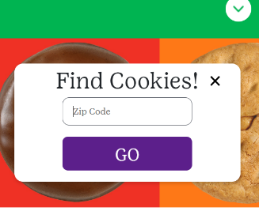
Cookie Booth Resources
GSUSA Cookie Finder
Cookie Booth & Sales Kit
Items for sale in the shop
Cookie Central/Smart Cookies
Sales per hour, booth instructions, step-by-step instructions
Cookie Chat on Booths

Slide 26
NEW: Cookie Pro Patch Program
Troops submit their unique cookie skills, customer service, marketing materials, or best pro tip to close the sale
One winner from DBJ & CSA
Cookie Pro of the Year
Grand prize of an Escape Room or Trampoline Park experience

Slide 27
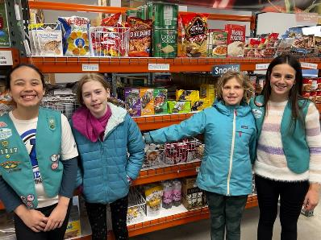
Cookie Care Donation Program
Last year, nearly 100,000 packages were donated in our council area!
It’s a great way to give back and an awesome inventory management tool!
Two donation options return:
River Valleys Donations
Virtual Cookie Share
Note: All shipped only donations will benefit this program
Troop Donations
Tracked Cookie Share
In-person, booth, & donations made via online orders for local delivery

Slide 28
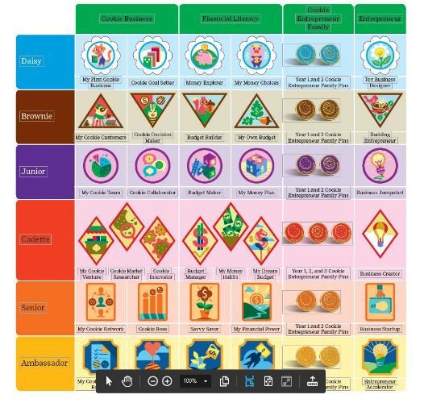
Cookie Badges
Entrepreneurship badges at each program level
Incorporates five business skills

Slide 29
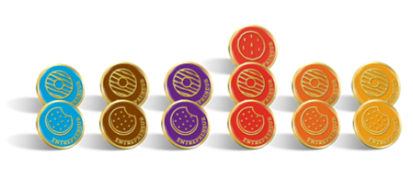
Parent/Guardian Participation
Family involvement is key to troop success
Opportunities to help support the troop
Talk to your Girl Scouts about their goals
Discuss the rewards they would like to earn & how they'd like to participate
Review the Family Entrepreneur pin guidelines, which features goal setting information

Slide 30
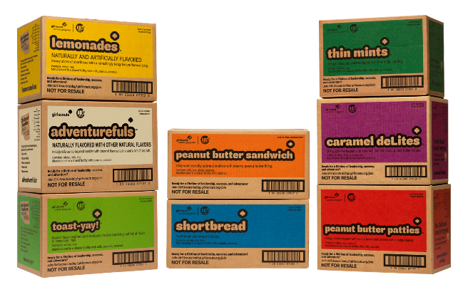
Initial Orders

Slide 31
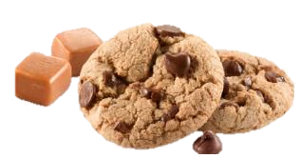
Gluten-Free Caramel Chocolate Chip Cookies
For troops that placed a pre-order:
Email reminder with order in early January
Troops must enter their order in Smart Cookies
For new troops or troops that did not place a pre-order:
Limit of two cases per troop
Exception request process in The Cookie Press
Not guaranteed to be in stock at cupboards

Slide 32
Initial Cookie Order: Due January 19
Using the Cookie Calculator: cookiecalculator.org
Recommendations for new & returning troops
Advice to troops:
Know how your Girl Scouts want to participate
The initial order is for those who:
Want cookies in hand on Go Day
Want a supply of the gluten-free cookies
Initial Order Reward:
Troops must order the total # of cases as recommended by the Cookie Calculator
2024 Year Bar patch for all selling in the troop
2 Cookie-themed car coasters for the adults
(1 per Juliette)

Slide 33
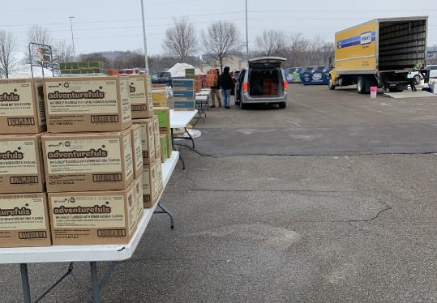
Initial Order Deliveries: Feb. 8-15
Our Service Unit participates in a mega drop delivery
Make sure you have enough space in your vehicle or bring multiple cars
Must go through line together if multiple cars picking up your initial order

Slide 34
Cookie Cupboards
Three types of Cookie Cupboards:
Council Cupboards-on demand orders
Council Express-planned orders, full cases
Regional Cupboards-planned orders
Pick up cookies by the case or package (except Council Express locations)
No exchanges except to replace damaged cookies
*Cupboard info coming to Cookie Central before Cookie Go Day

Slide 35
How to Use Cookie Cupboards
Review Cookie Central to view Council Cupboard location/hours/instructions
Demand for cookies decreases as the sale progresses
Check-in before using a cupboard:
Can I move cookies between girls?
Can I pick up cookies from other troops?
Cookie Swap

Slide 36
Helping Troops with Cookie Management
Encourage troops to:
Maintain good records
Collect at least 50% of money owed before providing additional inventory
Set a firm cookie return date
Write date in each Family Guide
Set a cookie schedule
Remind families cookies must be in “sell-able” condition
Assist troops with too many cookies

Slide 37
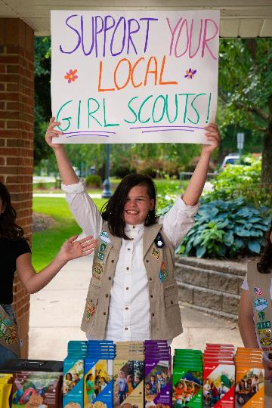
Managing Cookies Online with Smart Cookies
Record transfers & payments weekly
Review cupboard transfers for accuracy
Connect with (me/us) if you have issues in Smart Cookies

Slide 38
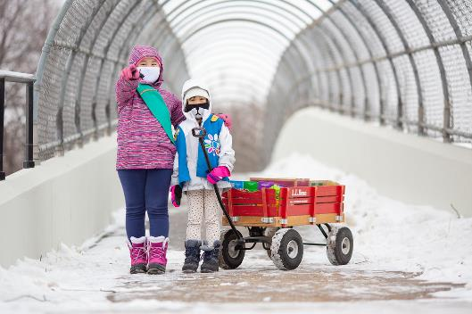
How to Handle Extra Cookie Inventory:
Schedule additional cookie booths or walkabouts
Business 2 Business sales
Cookie donations
Transfer cookies to other troops in the SU
Cookie Swap
Facebook Group
Finance/Inventory Issue Form (for an extension to sell excess inventory)

Slide 39
2024 Cookie Proceeds
TIER NAME | TIER REQUIREMENTS | TROOP PROCEED PER PKG. SOLD*
Base | Base | $0.90
PGA + Early Bird †(EB) | EB + met PGA of 235 | $1.00
*Senior and Ambassador troops can choose to opt-out of girl rewards and receive an additional $0.05 per package by emailing girlscouts@girlscoutsrv.org by April 1, 2024. Girls will still receive Cookie Program patches. † Troops that qualified for the Early Bird Bonus Proceeds registered at least one troop leader and half of the # of 2022-2023 members in the troop during the Early Bird Campaign.

Slide 40
Troop Bank Account Numbers
Account numbers uploaded into Smart Cookies
All troops must verify that the account number is correct (update if needed)
New troops must enter account numbers
TCMs do not need to be added to the troop bank account to deposit money

Slide 41
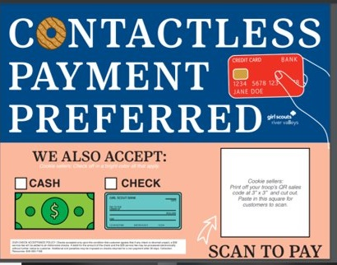
Family Payment Options from Customers
Credit card through Digital Cookie
Payment is deposited in the RV account
Troop is credited full sale price in Digital Cookie
No transaction fee charged to troop
Checks and cash also accepted
Checks can be made out to “Troop #” or “Girl Scouts”
Mobile payment services (such as Venmo) are NOT to be used to collect money from customers
Display flyer for accepted payment types

Slide 42
Troop Payment Options from Families
Deposits money collected from families into troop bank account
Deposit Weekly
Set-up schedule to turn in money
Payment options
Mobile Payment Services: Venmo, CashApp, PayPal Friends & Family
Checks and cash
Receipts MUST be exchanged for all money and cookie transactions
Required to submitted Finance/Inventory Issue Form
Track money collected from families in Smart Cookies
Juliette Girl Scouts deposit all money into River Valley's Wells Fargo account using encoded deposit tickets mailed directly to Juliette Mentor

Slide 43
Automated Clearing House (ACH)
First ACH
(March 15)
$1 x total packages received by the troop as of March 8, minus any credit card payments made through SC
Money needs to be in account by March 12
Refund ACH
(April 19)​
Only for Troops that are owed proceeds from taking only online orders or had more orders paid with credit cards.
Final ACH
(April 26)
Remaining balance owed to River Valleys.
Money to be deposited into the troop account by April 2
Finance/Inventory Issue Form due April 2 (if needed)
See ACH FAQ on Cookie Central for more information.

Slide 44
Finance/Inventory Issue Form
Due April 2:
Excess (unsold) troop inventory
Family unpaid balance
Juliette unpaid balance
TCM/TL unpaid balance
Stolen product/money or counterfeit money received
Due May 31:
Bank fee reimbursement
Returned check reimbursement
Other remaining situations
See the Finance/Inventory Issue Form FAQ on Cookie Central for more information.

Slide 45
When will I be able to log into Smart Cookies?
Timeframe | Who will have access?
Week of December 18 | Troop Leaders & Troop Cookie Managers
February 1 | All currently registered Girl Scouts & families
https://www.abcsmartcookies.com
Volunteers & Girl Scouts must register their Smart Cookies account each cookie season.
Add noreply@abcsmartcookies.com to your safe sender list!

Slide 46
Smart Cookies: Top 5 Things You Need to Know….
Troop sales management will continue in Smart Cookies.
Entering your initial order
Transferring/reviewing cookie inventory
Scheduling cookie booths & allocating booth sales
Entering reward choices
Crediting girls with cash/check payments
Running reports
2. SU volunteers can mimic Troop volunteers to assist with issues.

Slide 47
Smart Cookies: Top 5 Things You Need to Know….
3. Girl Scout online sales accounts move to Digital Cookie
4. Troop online sales links move to Digital Cookie.
5. Credit card sales will now be made in Digital Cookie
Check out our Understanding Roles in Smart Cookies & Digital Cookie Tip Sheet for an overview of the changes.

Slide 48
Smart Cookies: Resources
Smart Cookies Guide on Cookie Central
Safety & Training Tab in Smart Cookies
Girl Scouts River Valleys Staff
ABC Smart Cookies Help Desk: ABCSmartCookieTech@hearthsidefoods.com

Slide 49
Digital Cookie
Highlights of the new system
Access dates
Service Unit Basics
Troop Basics
Girl Scout Basics
Digital Cookie App
Resources

Slide 50
Digital Cookie
Digital Cookie is the new online platform that Girl Scouts and caregivers use for digital cookie sales.
All Girl Scouts and their families will get access to Digital Cookie on February 1st
Girl Scouts can use their Digital Cookie account to set up their online account sales link which they can share by email, text, social media, or even their parent/guardian workspaces:
Shipped cookie orders
Girl Scout Cookie delivery orders

Slide 51
Digital Cookie
Digital Cookie has great new features!
Customize your site & explore the learning activities
Ability for customers to purchase and pay online for local delivery
You can turn on/off local delivery at any time
Approve orders for local delivery in the site
You’ll receive an email reminder to login and approve orders if you have outstanding orders to approve
Note: Online orders for local delivery must be approved within 5 days or the order is cancelled.
Ability to turn on/off cookie varieties for local delivery
A robust Help section built right into the site with tip sheets & videos to assist if you need them

Slide 52
Digital Cookie
Digital Cookie Resources
Family Guide
Digital Cookie Guide for Families on Cookie Central
Help section in the site with tip sheets & videos
Watch for information on joining a Digital Cookie Rally in Rallyhood for families to connect on questions
Digital Cookie office hours provided by Girl Scouts River Valleys staff

Slide 53
Digital Cookie Highlights
Unified experience for all Girl Scouts & cookie customers
New & engaging site for Girl Scouts to supercharge their online sales
A robust Help section built right into the site for both families & volunteers
The Digital Cookie App for accepting Girl Scout & Troops credit card payments for booths & in-person sales

Slide 54
When will I be able to access Digital Cookie?
Timeframe | Who will have access?
January 22 | All Troop Leaders & Cookie Managers All Service Unit Cookie Managers & Managers
February 1 | Girl Scouts/Families
Add email@email.girlscouts.org to your safe sender list!

Slide 55
Digital Cookie: Role Selection
Toggle between accounts as a SU/Troop/Caregiver
Have multiple Girl Scouts? You can toggle between each account.
Parent role won’t appear until after Girl Scout access date.

Slide 56
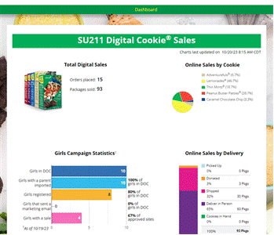
Digital Cookie: Basics for Service Units
Monitor the Service Unit digital sales
Pull reports for troop orders
Review the Girl Scouts that are engaging in the site
View the dashboard for a quick glance on how Troops are progressing through the season

Slide 57
Digital Cookie: Basics for Troops
What can Troops do in Digital Cookie?
Review digital sales progress for Girl Scouts
Review orders to view individual orders/process refunds
Set up Troop cookie links & virtual booths (optional)
Run reports

Slide 58
Troop Dashboard

Slide 59
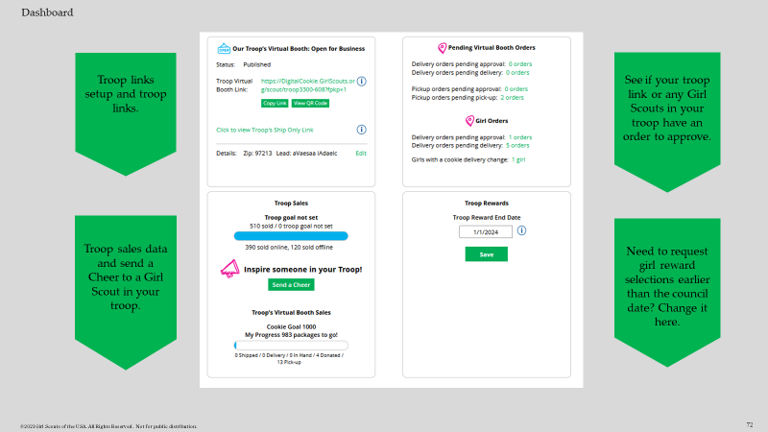
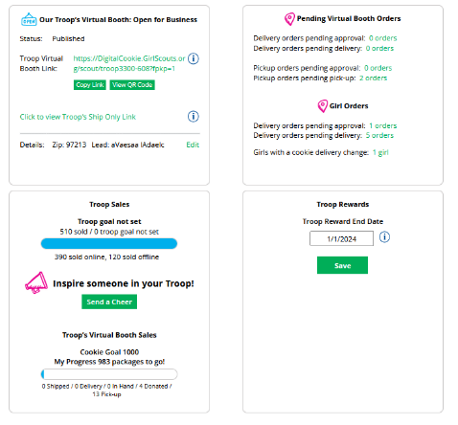
Dashboard
Troop links setup and troop links.
See if your troop link or any Girl Scouts in your troop have an order to approve.
Troop sales data and send a Cheer to a Girl Scout in your troop.
Need to request girl reward selections earlier than the council date? Change it here.

Slide 60
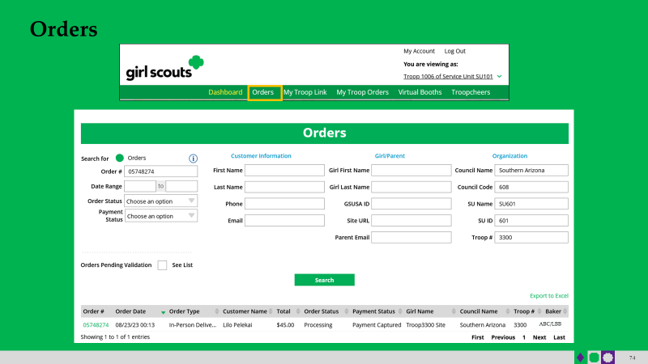
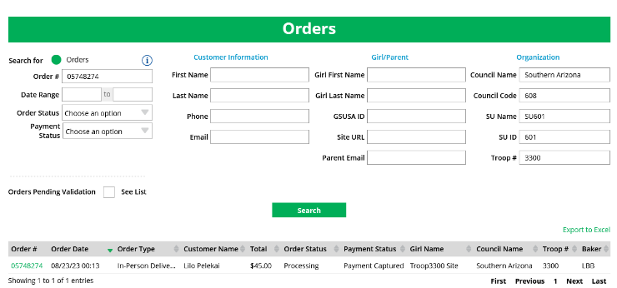
Where to go to refund an order
Orders
ABC/LBB

Slide 61
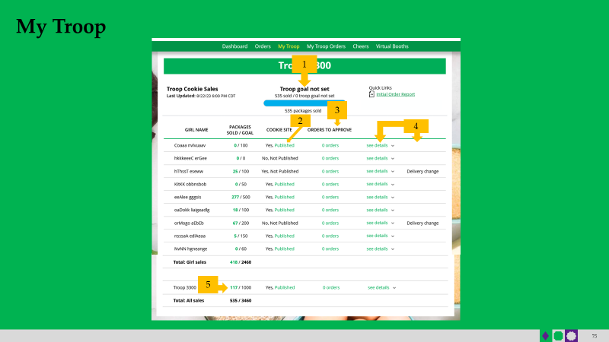
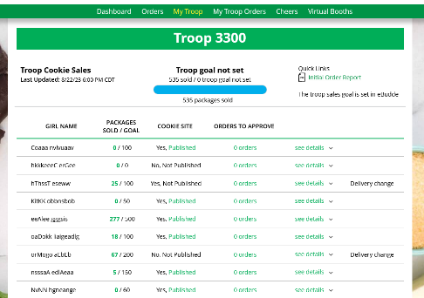
Review troop goal progress, cookie site publishing by girl, outstanding orders to approve, and click details to see order details by girl and if she has turned off any varieties
My Troop
1
3
2
4
5

Slide 62
Digital Cookie: Basics for Girl Scouts
What can Girl Scouts do in Digital Cookie?
Get started in four easy steps!
Utilize customization options for marketing their cookie sale
Turn on/off cookie varieties
Approve online orders for local delivery in the site!
Make reward selections to alert the Troop volunteer of their choices

Slide 63
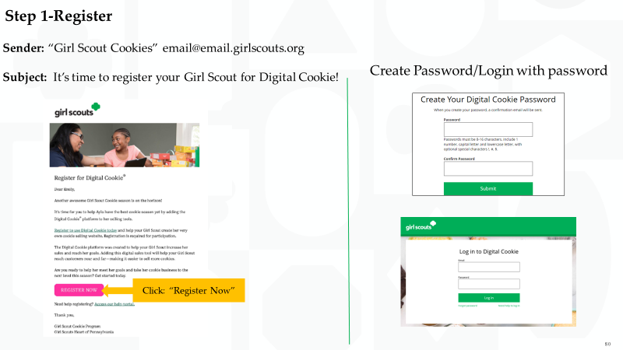
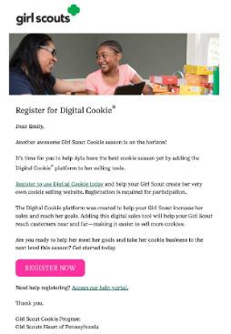
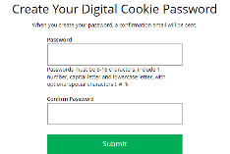
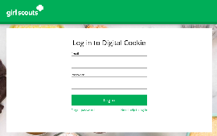
Step 1-Register
Sender: “Girl Scout Cookies” email@email.girlscouts.org
Subject: It’s time to register your Girl Scout for Digital Cookie!
Create Password/Login with password
Click: “Register Now”

Slide 64
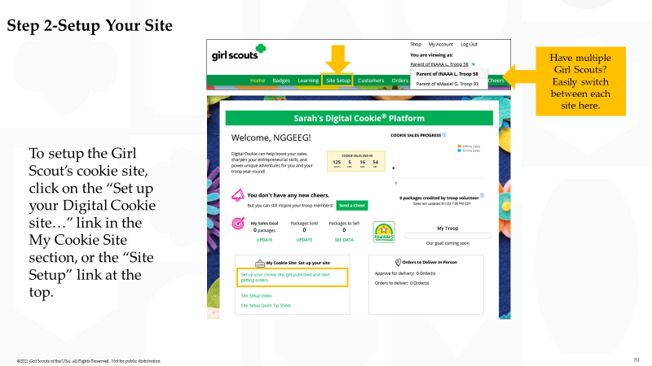
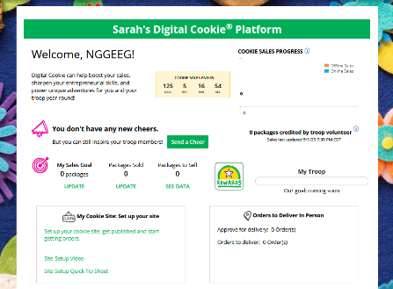
Step 2-Setup Your Site
Have multiple Girl Scouts? Easily switch between each site here.
To setup the Girl Scout’s cookie site, click on the “Set up your Digital Cookie site…” link in the My Cookie Site section, or the “Site Setup” link at the top.

Slide 65
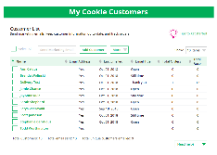
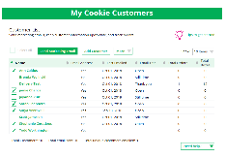
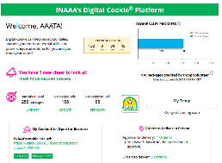
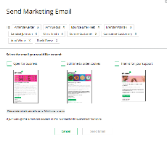
Step 3-Invite Customers
Copy URL
Email link or share QR code
Add or import customers
Send one of three marketing emails
1
2
4
OR
3

Slide 66
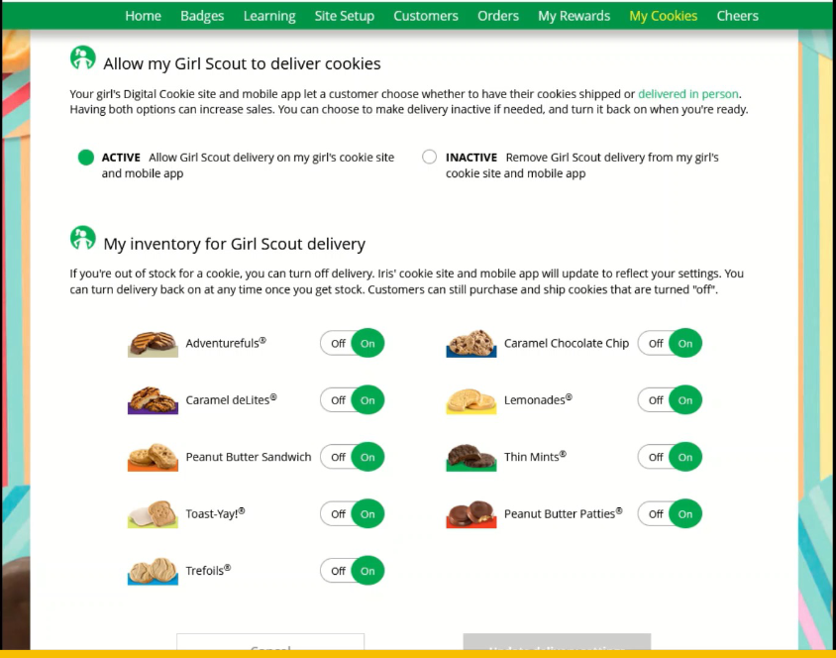
Step 4: Track Progress/Orders: How to set up local delivery & turn on/off varieties

Slide 67
To recap:
Girl Scouts can opt in/opt out for in person delivery
Can change at any time during the sale
Orders for local delivery must be approved within 5 business days or orders will be canceled
Turn on/turn off cookie varieties

Slide 68
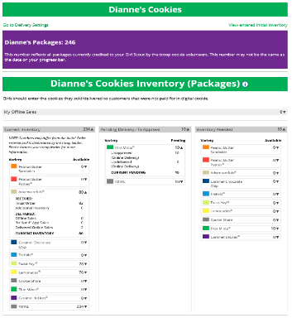
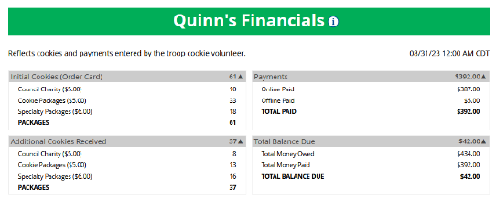
Step 4-Track Progress/Orders
My Cookies Tab-Inventory by Variety & Finances
1
2
3

Slide 69
Digital Cookie Mobile App
Your Digital cash register for in-person & booth sales:
Set up Digital Cookie site with a browser
Download app
Login with your DC email & password
Available from the App Store & Google Play Store. View the Mobile App Tip Sheet coming to Cookie Central.

Slide 70
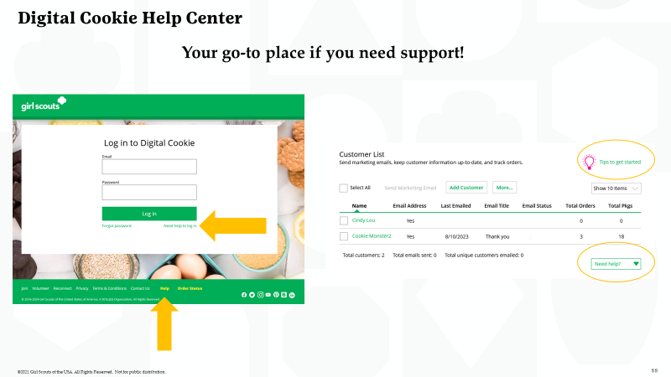
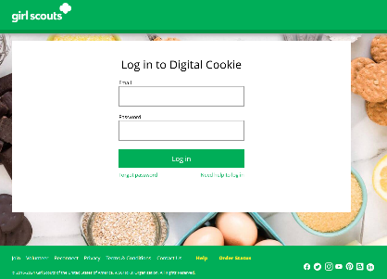
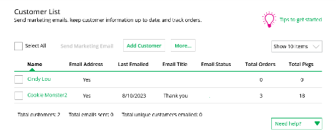
Digital Cookie Help Center
Your go-to place if you need support!

Slide 71
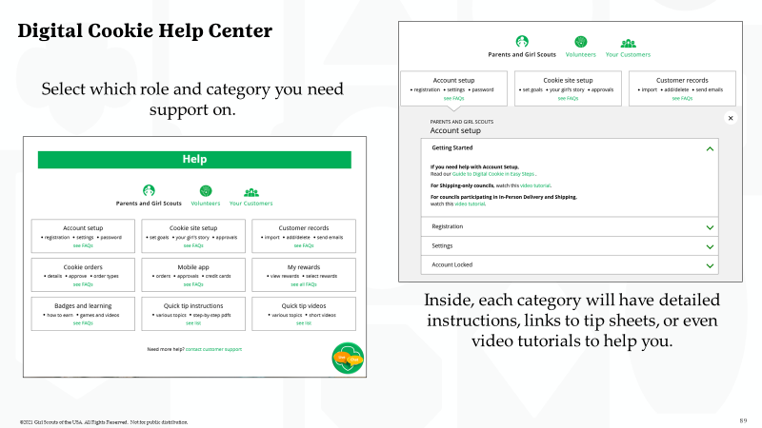
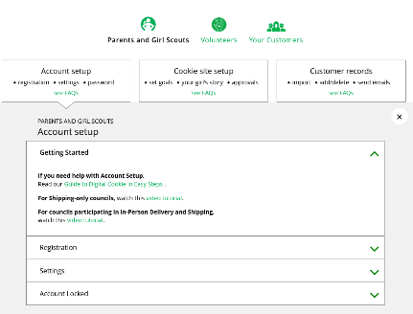
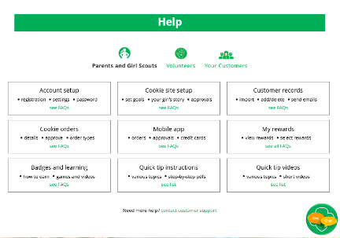
Digital Cookie Help Center
Select which role and category you need support on.
Inside, each category will have detailed instructions, links to tip sheets, or even video tutorials to help you.

Slide 72
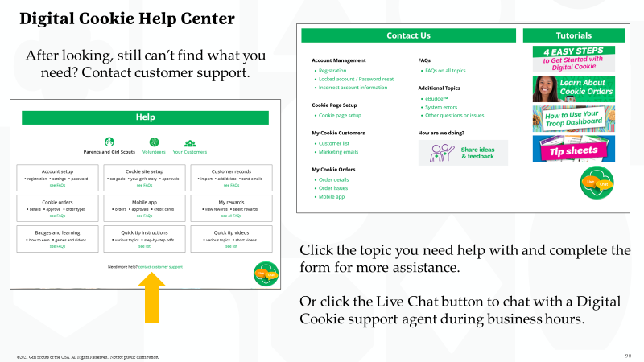
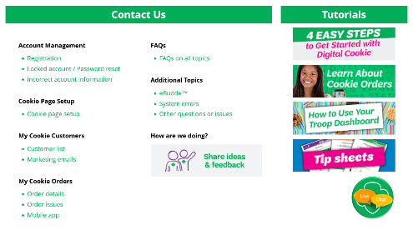
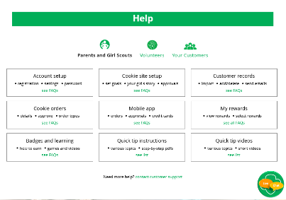
Digital Cookie Help Center
After looking, still can’t find what you need? Contact customer support.
Click the topic you need help with and complete the form for more assistance.
Or click the Live Chat button to chat with a Digital Cookie support agent during business hours.

Slide 73
Digital Cookie Resources
Digital Cookie Guides on Cookie Central
Girl Scouts River Valleys Staff
Digital Cookie Rally in Rallyhood
Cookie Chat on Digital Cookie
Digital Cookie Office Hours

Slide 74
Key Takeaways
Volunteers will use Smart Cookies for 2024.
Girl Scouts will use Digital Cookie for online sales in 2024. Troops that wish to engage in online sales also use Digital Cookie.
Credit card payments for in-person and cookie booth sales are made through the Digital Cookie app.
Familiarize yourself with AND direct troops to the Smart Cookies and Digital Cookie learning resources

Slide 75
Your Cookie Support System: We got you!
GIVE US A CALL 800-845-0787
Phone line hours: M-F, 9 AM-5 PM
SEND US AN EMAIL
girlscouts@girlscoutsrv.org
PEER-TO-PEER SUPPORT
Girl Scout River Valleys Service Unit Product Program Volunteers
Girl Scout River Valleys Troop Product Program Volunteers
FIND US ONLINE
The Cookie Press e-newsletter
Rallyhood
Cookie Central

